Slide 1
CGB1221 – DATABASE MANAGEMENT SYSTEMS END SEMESTER PROJECT REVIEW
Department of Computer Science and Engineering
Academic Year: 2024 – 2025 (Even Semester)
Register Number : 927623BCS011
Name : ARUN SANJEEV M S
Year : II
Semester : IV
Section : CSE-A
Date : 02/06/2025

Slide 2
Title of the Project
BUS RESERVATION SYSTEM

Slide 3
Abstract
The Bus Ticket Booking System is a database management system designed to automate the process of booking bus tickets for passengers.
This system aims to simplify ticket reservations by allowing users to search for available buses based on departure and arrival locations, dates, and times.
It enables users to book tickets, make secure online payments, and view their booking history.
The system maintains essential details such as bus schedules, passenger information, ticket availability, and payment records.
Additionally, administrators can manage bus schedules, monitor bookings, and generate detailed reports for better operational management.
The project enhances efficiency, reduces manual work, and improves user satisfaction by providing a streamlined and user-friendly ticket booking experience.

Slide 4
Abstract with CO/PO Mapping
Abstract | CO | POs | PSO
The Bus Ticket Booking System is a database-based application designed to automate bus ticket reservations. It allows users to search buses, book tickets, make payments, and view booking history. The system manages bus schedules, passenger details, and payment transactions, while administrators can update schedules, monitor bookings, and generate reports. This system improves efficiency, reduces manual work, and provides a seamless booking experience. | CO1 CO2 | PO1 PO2 PO3 PO5 PO8 PO10 PO11 PO12 | PSO1 PSO2

Slide 5
Introduction
The Bus Booking System is a database-driven web application for booking bus tickets online.
Designed to simplify the reservation process for passengers and enhance operational efficiency for bus operators.
Users can search for buses, check availability, book tickets, and make payments securely.
The system ensures real-time seat availability updates and automated booking management.
Implements a relational database model to store passenger details, booking history, bus schedules, and payment records.
Developed using DBMS concepts for efficient data storage, retrieval, and management.
Aims to reduce manual workload, minimize errors, and provide a seamless user experience.

Slide 6
DBMS Concepts Used
Entity Relationship Model
Normalization
Primary and Foreign keys
ACID Properties
Query Optimization
Data Security

Slide 7
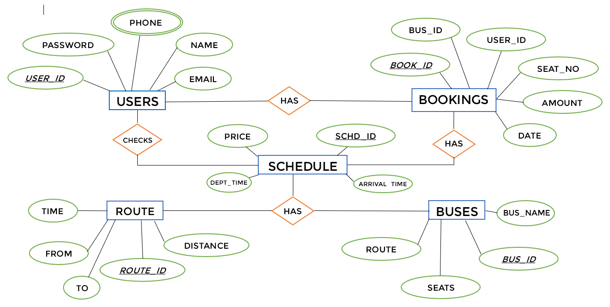
E-R DIAGRAM

Slide 8
Proposed System Architecture
Web Application
Authentication
User
Admin
Booking
Bus management
Bus search
Payment
Report generation
Database management system

Slide 9
Proposed System - Description
Users can register and log in to access the system.
They can search for buses based on departure and arrival locations.
Users select seats and proceed to payment through Payment Gateway.
Bookings are confirmed, and users can view booking history.
Admins can manage bus schedules, monitor bookings, and generate reports.
The system is designed for efficiency, security, and real-time booking updates.
SOS and Alternative trip plan
.

Slide 10
List of Modules
Authentication Module
User Module
Admin Module
Bus Search Module
Booking Module
Payment Module
Bus Management Module
Report Generation Module
.

Slide 11
Module Description
Authentication Module
Responsible for user login and registration.
Verifies user credentials and provides access to authorized modules.
User Module
Allows users to view available buses, book tickets, and check booking history.
Admin Module
Provides access to admin functionalities like managing bus details, bookings, and generating reports.
Bus Search Module
Helps users search for available buses based on departure location, arrival location, and date.
Booking Module
Manages Bus ticket bookings, seat availability and payment integration
Verifies user credentials and provides access to authorized modules.
.

Slide 12
Module Description (Cont..)
Payment Module
Allows users to view available buses, book tickets, and check booking history.
Handles payment transactions for booked tickets.
Stores payment details and status.
Bus Management Module
Allows admins to add, update, or delete bus schedules and manage seat availability.
Report Dashboard Module
Views Dashboard on bookings, payments, and bus schedules for admin analysis.
.

Slide 13
Software Specification (Tools / Programming Languages used)
Front End
HTML
CSS
Java Script
Backend
PHP
Database
MySQL.
.

Slide 14
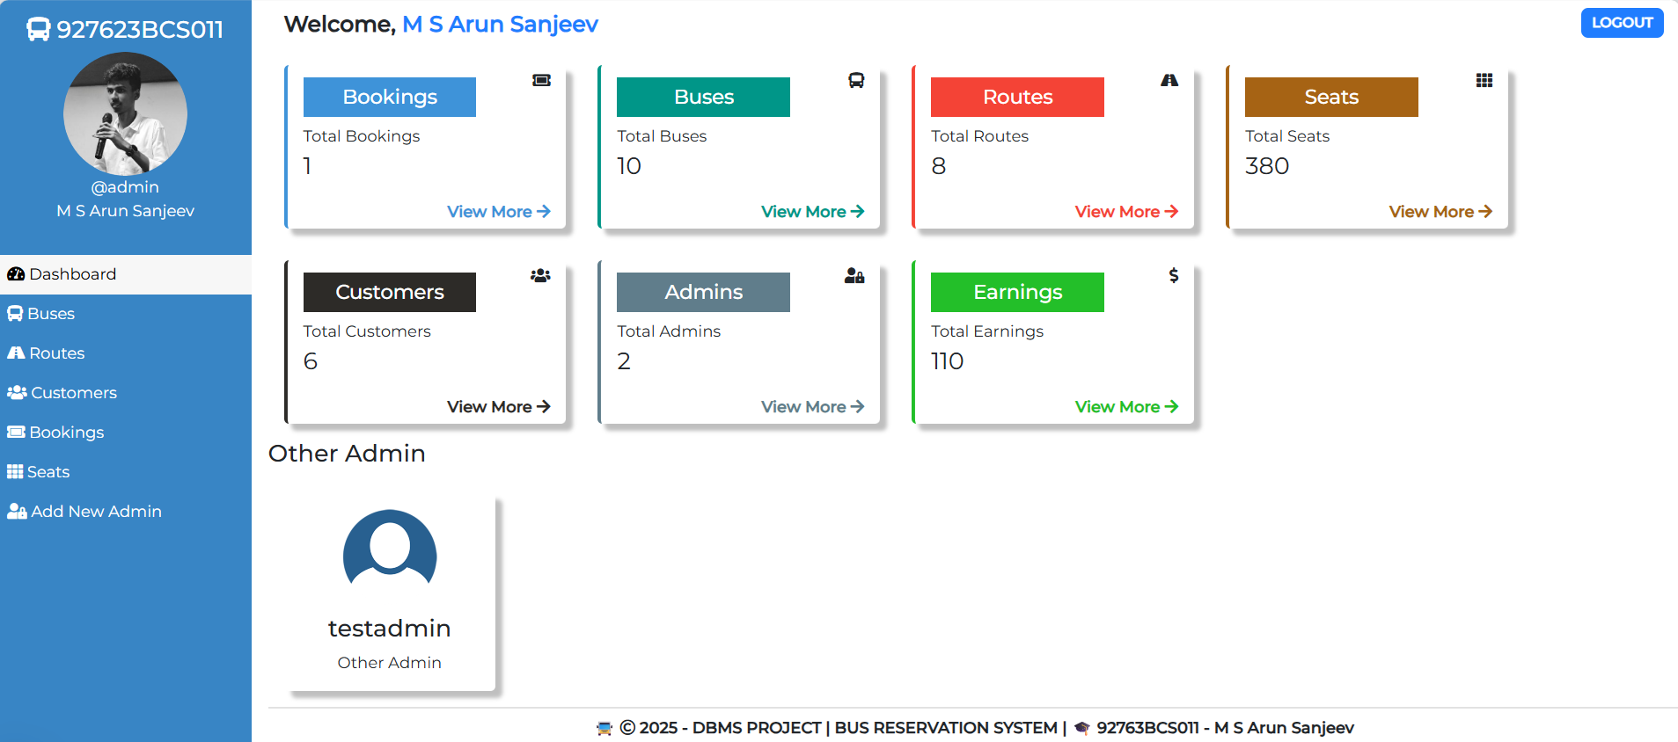
Sample Screen shot
.

Slide 15
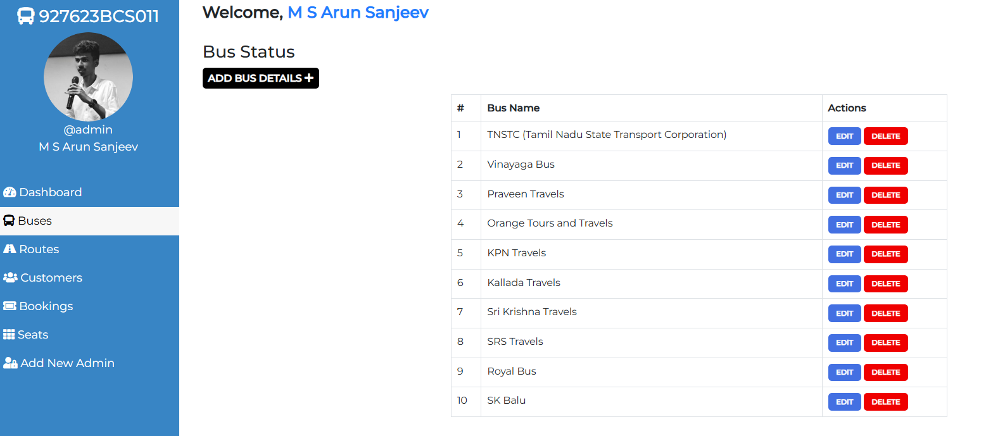
Sample Screen shot
.

Slide 16
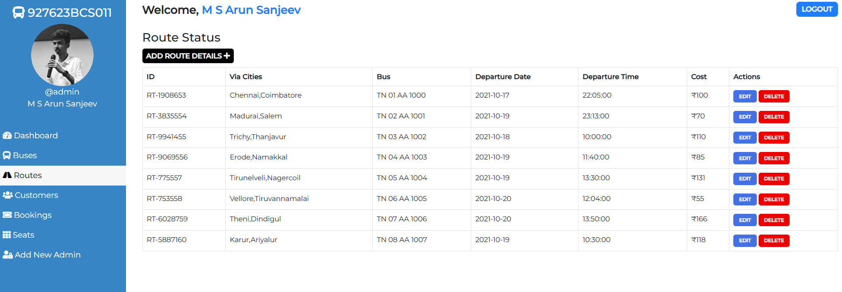
Sample Screen shot
.

Slide 17
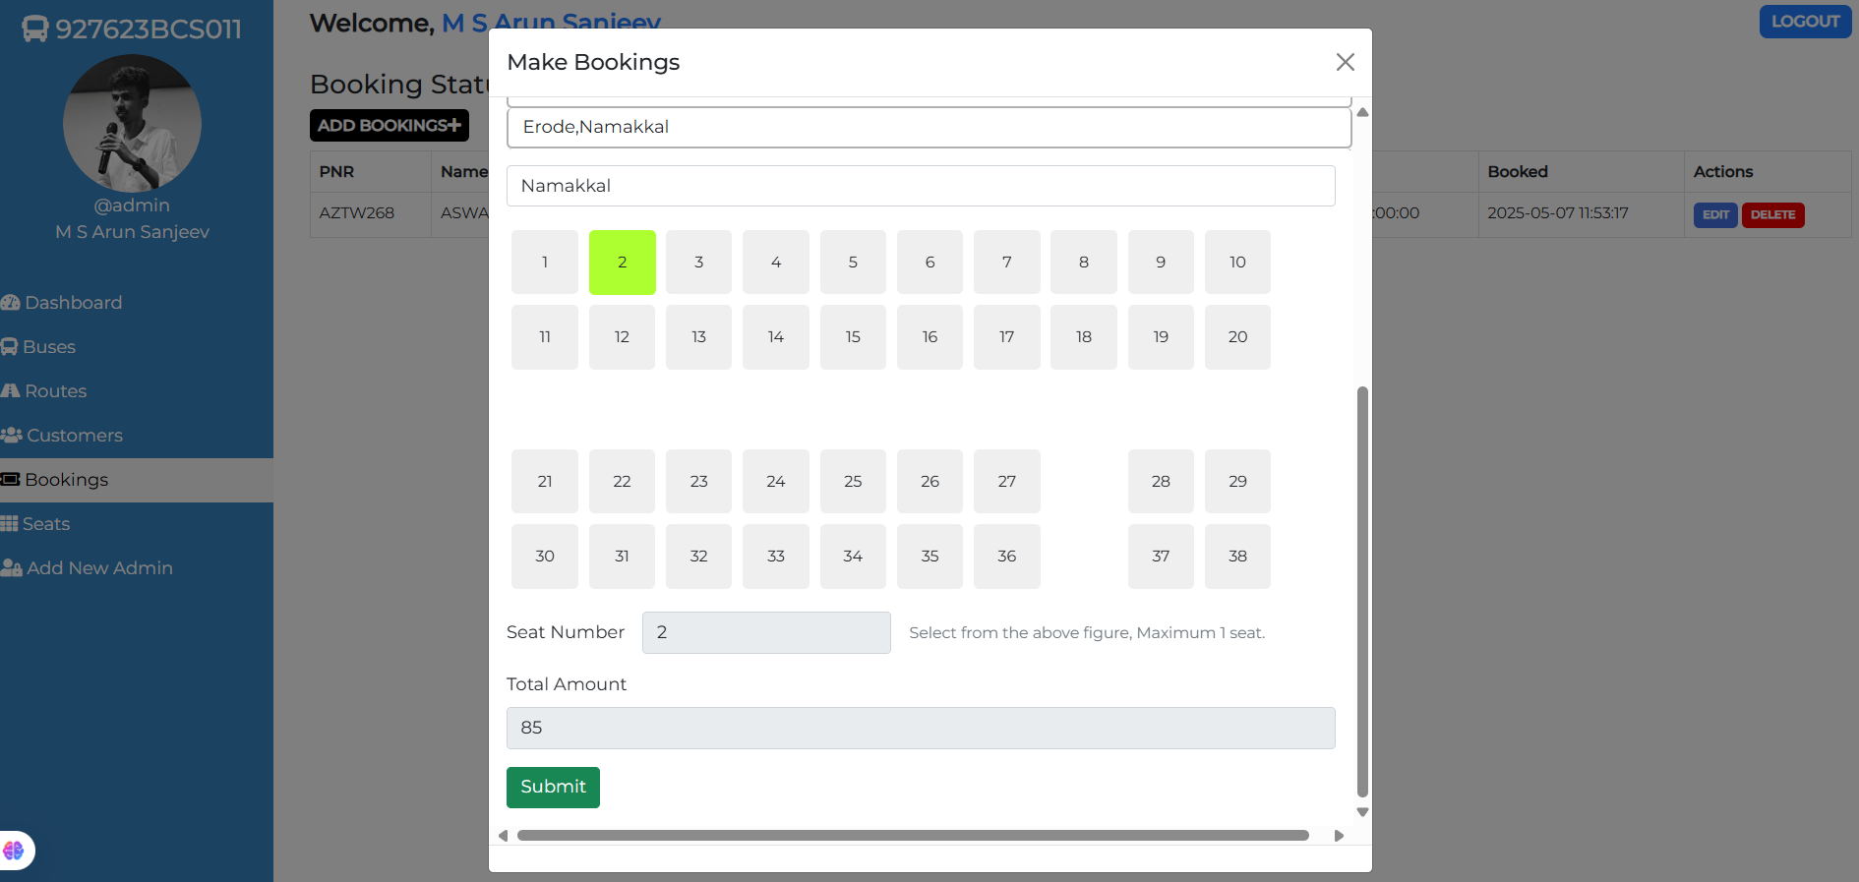
Sample Screen shot
.

Slide 18
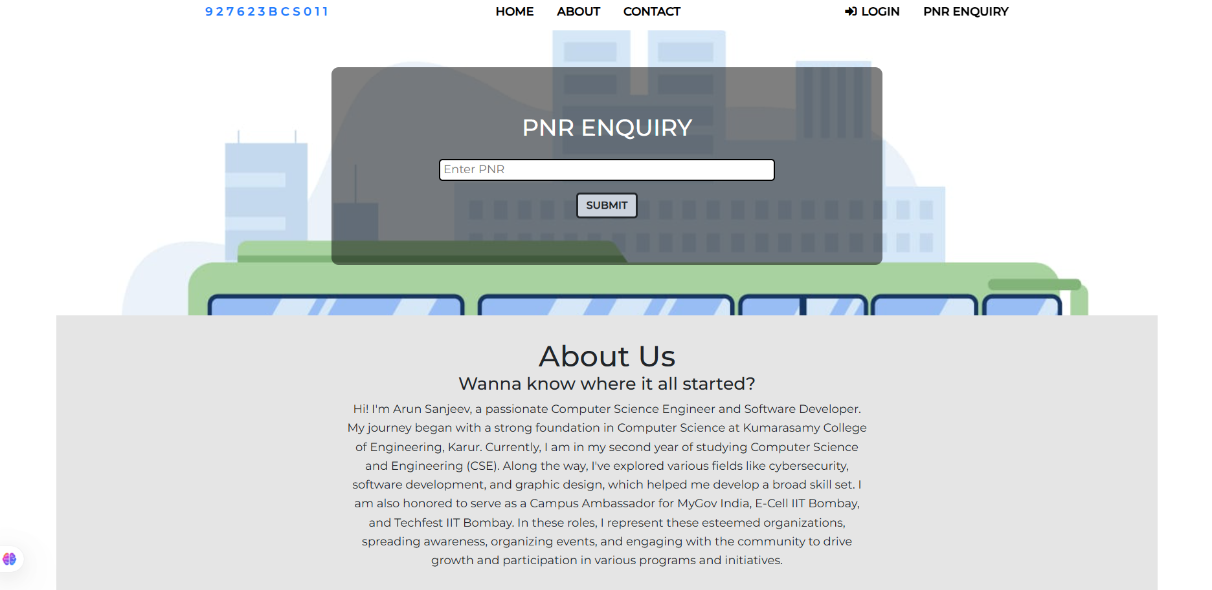
Sample Screen shot
.

Slide 19
Conclusion
The Bus Booking System is a robust and user-centric platform that automates the complete process of bus ticket reservations, schedule and route management, and passenger data handling. By incorporating distinct modules for users and administrators, the system ensures seamless interaction, real-time updates, and efficient control over operations. Users can easily search for buses, view seat availability, and make secure bookings, while administrators can manage bus information, fares, and user data through a dedicated backend panel. Developed using a secure PHP-MySQL framework, the system ensures data confidentiality, integrity, and protection against common web vulnerabilities. Its intuitive interface, responsive design, and reliable performance significantly enhance the user experience while also enabling transport providers to reduce manual workload, eliminate booking errors, and operate more efficiently.
.

Slide 20

Thank You
ANY QUERIES???

Slide 21
New Innovations
AI-Powered Seat Recommendation
Implement an AI algorithm that suggests the best available seat based on user preferences
2. Dynamic Pricing Model
Implement a real-time fare adjustment system based on demand, time of booking, and availability.
3. Smart Route Optimization
Analyze traffic data and suggest the fastest or less congested routes for buses in real-time.
Update customers about delays dynamically.
4. Waitlist and Auto-Upgrade System
If seats are full, users can join a waitlist and get an auto-upgrade if a seat becomes available.
5. Carbon Footprint Calculator
Show users the CO2 emissions saved by taking a bus instead of a car, promoting eco-friendly travel.
6. Offline Ticket Generation with QR Code
Allow users to generate an offline QR code ticket that can be scanned at the boarding.
.

